Slide 1


H. Z.
March 23, 2023

Slide 2

Outline
Executive Summary
Introduction
Methodology
Results
Conclusion
Appendix

Slide 3
Executive Summary
we collect data from SpaceX REST API and related Wiki pages and perform data wrangling. Perform exploratory data analysis by using visualization and SQL, then build an interactive dashboard, then build different classification models
All results
Scalarized Falcon 9 data
An interactive dashboard
Different classification models

Slide 4
Introduction
Project background and context
The commercial space age is here
companies are making space travel affordable for everyone
Space Y wants to win this Space Race
Problems you want to find answers
To determine the price of each launch
To determine if SpaceX will reuse the first stage
To predict if the Falcon 9 first stage will land successfully

Slide 5

Section 1

Slide 6
Methodology
Executive Summary
Data collection methodology:
Request the SpaceX REST API
Web scraping related Wiki pages
Perform data wrangling
Replace null value, replace ids with names, filter data, label dependent column
Perform exploratory data analysis (EDA) using visualization and SQL
Perform interactive visual analytics using Folium and Plotly Dash
Perform predictive analysis using classification models
Build classification models by multiple algorithms, evaluate and improve them

Slide 7
Data Collection
Request the SpaceX REST API endpoints
All launches: https://api.spacexdata.com/v4/launches/past
Booster Versions: https://api.spacexdata.com/v4/rockets/ + rocket
Launch Sites: https://api.spacexdata.com/v4/launchpads/ + launchpad
Payload data: https://api.spacexdata.com/v4/payloads/ + load
Core data: https://api.spacexdata.com/v4/cores/ + core
Web Scraping
List of Falcon 9 and Falcon Heavy launches: https://en.wikipedia.org/wiki/List_of_Falcon_9_and_Falcon_Heavy_launches

Slide 8
Data Collection – SpaceX API
Request SpaceX API Url
key phrases and flowcharts
GitHub URL of the completed SpaceX API calls notebook:
https://github.com/zhq5101/learning-data-science/blob/main/jupyter-labs-spacex-data-collection-api.ipynb
Get Json response
Normalize Json to create a data frame
Replace IDs with names
Filter data frame to get Falcon 9 launches

Slide 9
Data Collection - Scraping
Request Wiki page
key phrases and flowcharts
the GitHub URL of the completed web scraping notebook
https://github.com/zhq5101/learning-data-science/blob/main/jupyter-labs-webscraping.ipynb
Get HTML text response
Create BeautifulSoap object from text content
Extract all column names and table content
Create a data frame

Slide 10
Data Wrangling
Dealing with missing values
Firstly, dealing with missing values and identify column types
Secondly, calculate some important features for understanding the domain deeply
Finally, labelling dependent variable
the GitHub URL of your completed data wrangling related notebooks
https://github.com/zhq5101/learning-data-science/blob/main/labs-jupyter-spacex-Data-wrangling.ipynb
Identify column types
Calculate the number about launches and orbits
Calculate the mission outcomes for each orbits
Create a landing outcome label

Slide 11
EDA with Data Visualization
Five scatter point charts
To visualize the relationship between Flight Number and Launch Site
To find the relationship between Payload and Launch Site
To check any relationship between Flight Number and Orbit type
A bar chart
To check any relationship between success rate and orbit type
A line chart
To show the average launch success trend
The GitHub URL of my completed EDA with data visualization notebook:
https://github.com/zhq5101/learning-data-science/blob/main/jupyter-labs-eda-dataviz.ipynb

Slide 12
EDA with SQL
Limit the rows and columns of result output: select columns … limit 5
Distinct rows: distinct column
Filter rows: where condition and/or condition
Group rows: group by column
Use a subquery: select … where column = (select column from … where …)
Sort result: order by column ASC/DESC
The GitHub URL of my completed EDA with SQL notebook
https://github.com/zhq5101/learning-data-science/blob/main/jupyter-labs-eda-sql-coursera_sqllite.ipynb

Slide 13
Build an Interactive Map with Folium
A map can visually show the location of the place and the surrounding geographical environment
We use a map to find some geographical patterns about launch sites
Add different signs on a map to highlight the key information we want to show
Markers, circles, lines, text
The GitHub URL of your completed interactive map with Folium map
https://github.com/zhq5101/learning-data-science/blob/main/lab_jupyter_launch_site_location.jupyterlite.ipynb

Slide 14
Build a Dashboard with Plotly Dash
Dashboard enables users to explore and manipulate data in an interactive and real-time way
We add two input components to the Dashborad
a Dropdown list – choose a launch site or all launch sites
a range – choose payload range
The GitHub URL of your completed Plotly Dash lab
https://github.com/zhq5101/learning-data-science/blob/main/spacex_dash_app.py

Slide 15
Predictive Analysis (Classification)
Split the data into training and test data
Summarize how you built, evaluated, improved, and found the best performing classification model
Firstly, split the data frame into training and test data
Secondly, build models by multiple algorithms, evaluate and improve models
Finally, find out the best performing algorithms
The GitHub URL of your completed predictive analysis lab
https://github.com/zhq5101/learning-data-science/blob/main/SpaceX_Machine_Learning_Prediction_Part_5.jupyterlite.ipynb
Build models by multiple algorithms
evaluate models and get their Accuracies
Change parameters to improve models
Find out the best performing algorithms

Slide 16
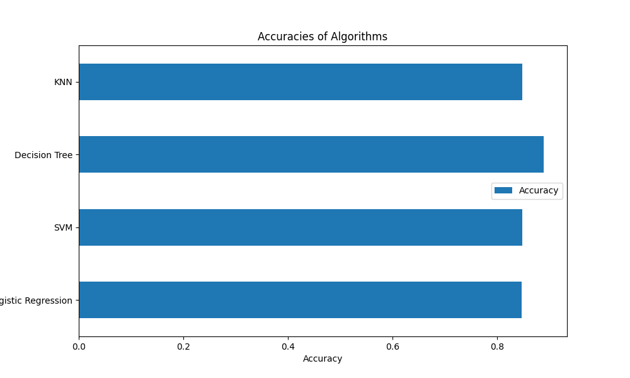
Results
Exploratory data analysis results
Interactive analytics demo in screenshots
Predictive analysis results

Slide 17

Section 2

Slide 18
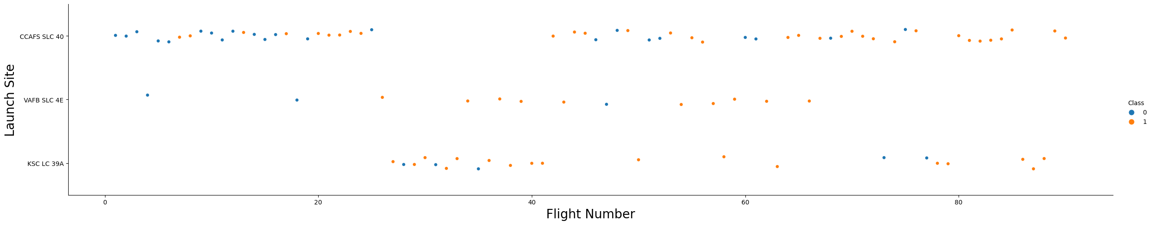
Flight Number vs. Launch Site
Show a scatter plot of Flight Number vs. Launch Site
Show the screenshot of the scatter plot with explanations
The Launch Site CCAFS SLC 40 has the highest launch times.

Slide 19
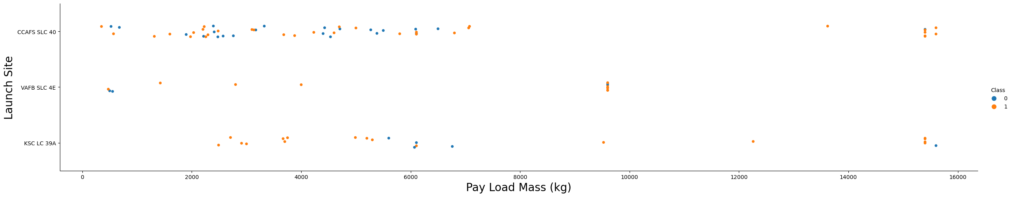
Payload vs. Launch Site
Show a scatter plot of Payload vs. Launch Site
Show the screenshot of the scatter plot with explanations
When the payload is between 2000~55KG the Launch Success Ratio is the highest

Slide 20
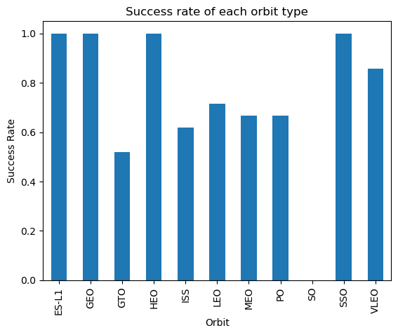
Success Rate vs. Orbit Type
Show a bar chart for the success rate of each orbit type
Show the screenshot of the scatter plot with explanations
ES-L1, GEO, HEO and SSO orbits have 100% success Rate

Slide 21
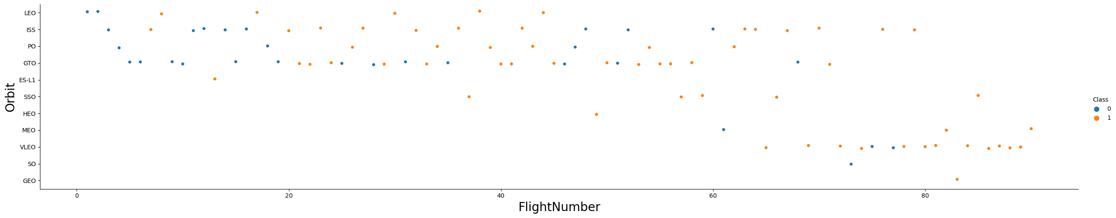
Flight Number vs. Orbit Type
Show a scatter point of Flight number vs. Orbit type
Show the screenshot of the scatter plot with explanations
In the LEO orbit, the Success appears related to the number of flights

Slide 22
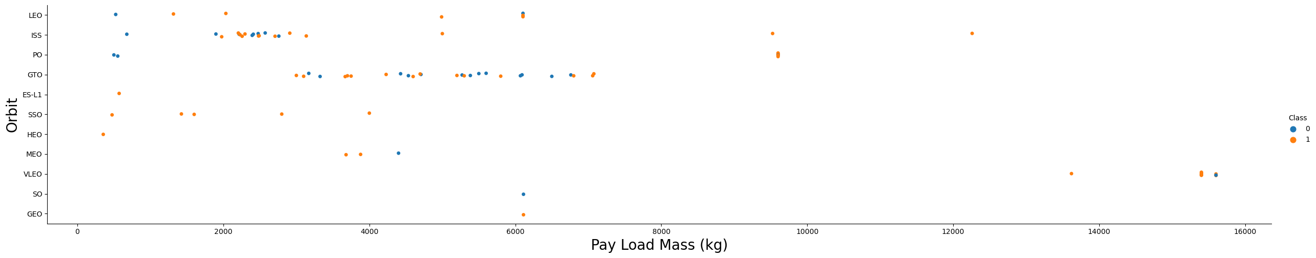
Payload vs. Orbit Type
Show a scatter point of payload vs. orbit type
Show the screenshot of the scatter plot with explanations
With heavy payloads the successful landing or positive landing rate are more for Polar, LEO and ISS

Slide 23
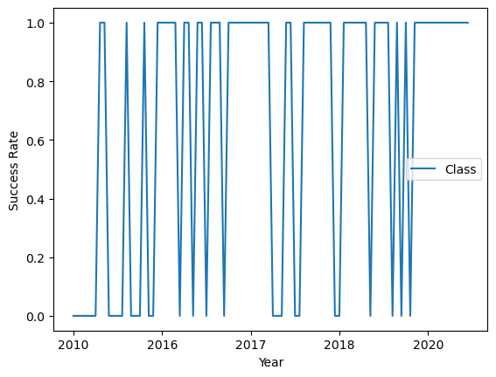
Launch Success Yearly Trend
Show a line chart of yearly average success rate
Show the screenshot of the scatter plot with explanations
The success rate since 2013 kept increasing till 2020

Slide 24
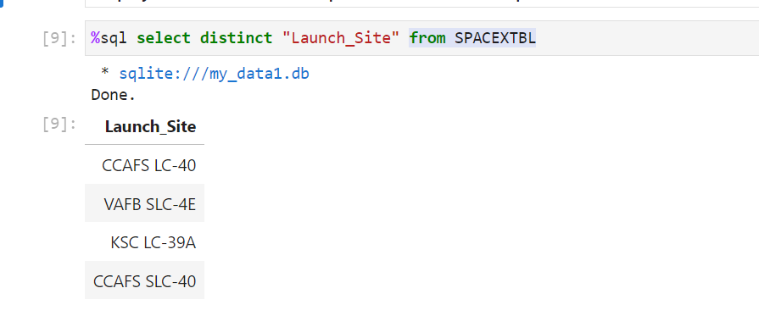
All Launch Site Names
Find the names of the unique launch sites
Present your query result with a short explanation here
Use “distinct” key word to get the names of the unique launch sites

Slide 25
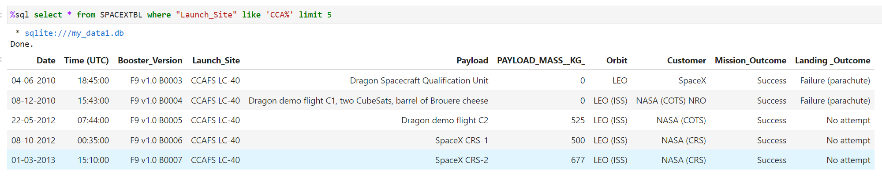
Launch Site Names Begin with 'CCA'
Find 5 records where launch sites begin with `CCA`
Present your query result with a short explanation here
Here we use ‘like’ key word and ‘%’ following ‘CCA’ to get all records which launch site names begin with ‘CCA’
We use ‘limit 5’ to display only 5 records

Slide 26
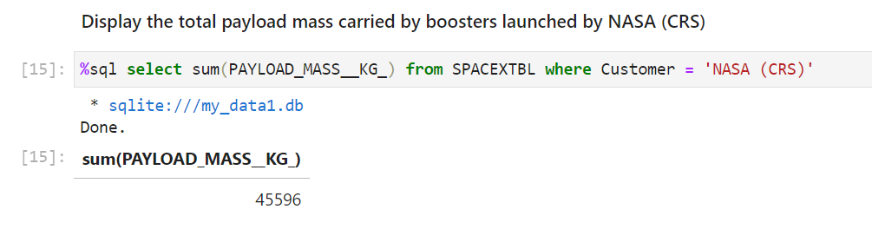
Total Payload Mass
Calculate the total payload carried by boosters from NASA
Present your query result with a short explanation here
Use where subclause to get all records which were launched by NASA(CRS)
Use sum function to get the total payload mass

Slide 27
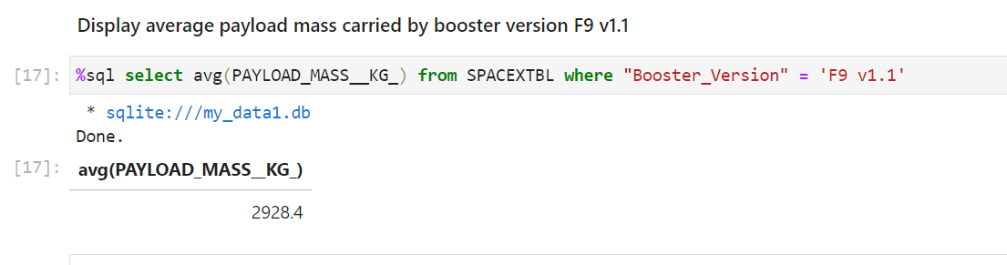
Average Payload Mass by F9 v1.1
Calculate the average payload mass carried by booster version F9 v1.1
Present your query result with a short explanation here
Use where subclause to get all records which booster version are F9 v1.1
Use avg function to get the average payload mass

Slide 28
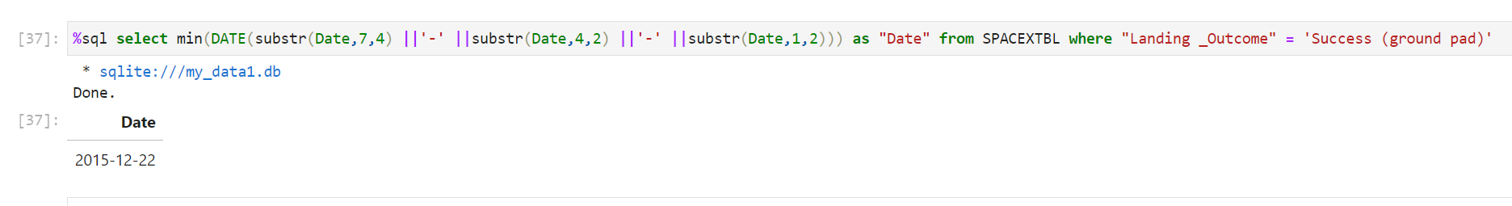
First Successful Ground Landing Date
Find the dates of the first successful landing outcome on ground pad
Present your query result with a short explanation here
Use where subclause to get records which landing outcomes are Success (ground pad)
Use substr function to convert date string to “yyyy-mm-dd” pattern
Use min function to get the first successful ground landing date

Slide 29
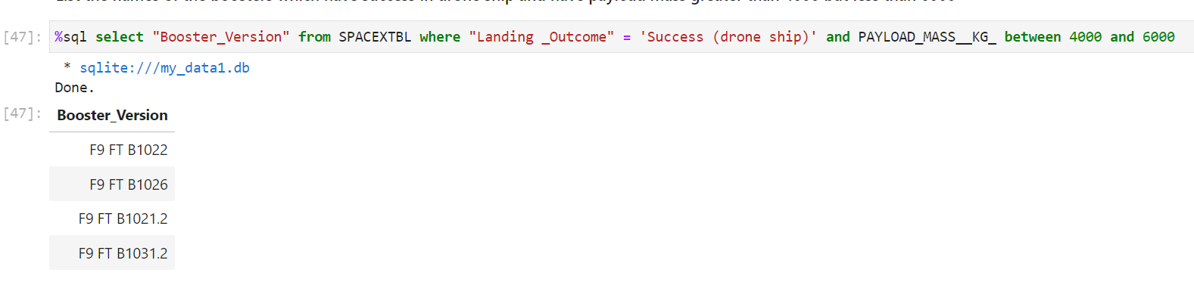
Successful Drone Ship Landing with Payload between 4000 and 6000
List the names of boosters which have successfully landed on drone ship and had payload mass greater than 4000 but less than 6000
Present your query result with a short explanation here
Use where subclause to get records which landing outcomes equal Success (drone ship) and payloads are between 4000 and 6000 to filter

Slide 30
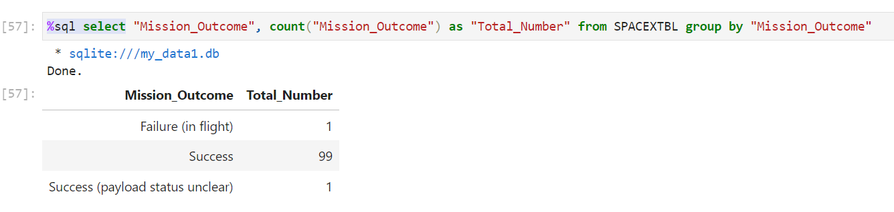
Total Number of Successful and Failure Mission Outcomes
Calculate the total number of successful and failure mission outcomes
Present your query result with a short explanation here
Use group by subclause to get unique mission outcome
Use count function to get the total number for each group

Slide 31
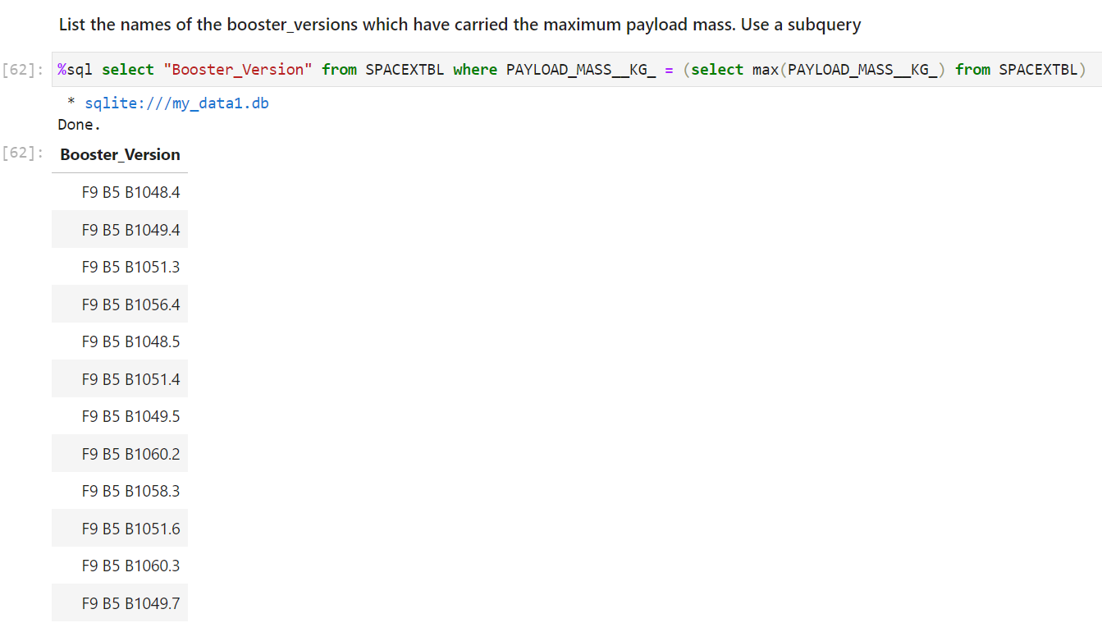
Boosters Carried Maximum Payload
List the names of the booster which have carried the maximum payload mass
Present your query result with a short explanation here
Use a subquery to get the maximum payload and use where to filter

Slide 32
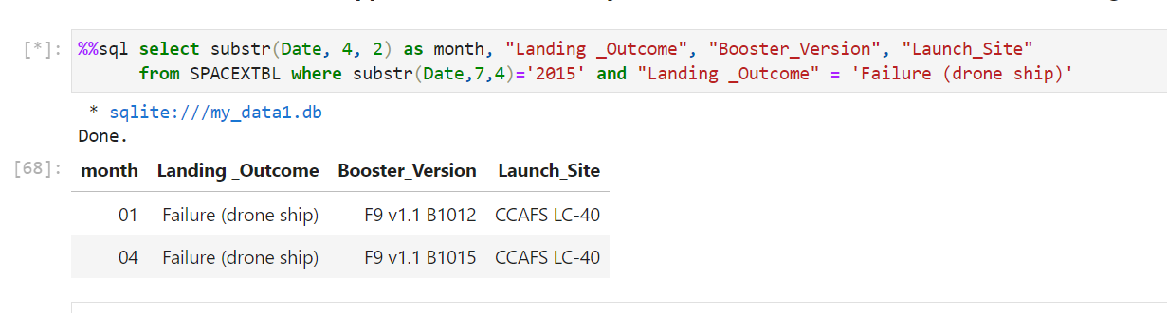
2015 Launch Records
List the failed landing_outcomes in drone ship, their booster versions, and launch site names for in year 2015
Present your query result with a short explanation here
Use substr function to get month or year
Use where subclause to filter records

Slide 33
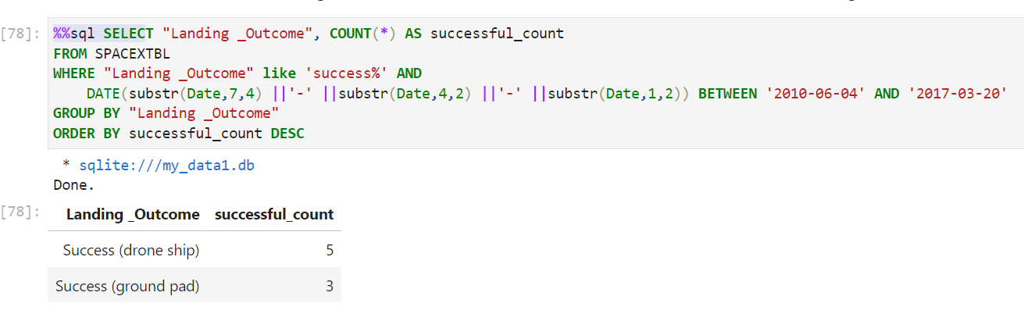
Rank Landing Outcomes Between 2010-06-04 and 2017-03-20
Rank the count of landing outcomes (such as Failure (drone ship) or Success (ground pad)) between the date 2010-06-04 and 2017-03-20, in descending order
Present your query result with a short explanation here
Use substr function to convert date to “yyyy-mm-dd” pattern
Use where subclause to filter records by date
Use group by subclause to group records and use order by DESC to sort records

Slide 34

Section 3

Slide 35
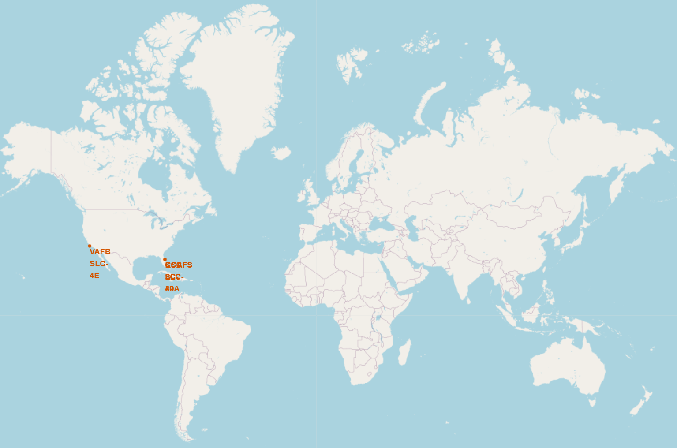
All Launch Sites Location on a Folium Map
Replace <Folium map screenshot 1> title with an appropriate title
Explore the generated folium map and make a proper screenshot to include all launch sites’ location markers on a global map
Explain the important elements and findings on the screenshot
All Sites are near a coast.

Slide 36
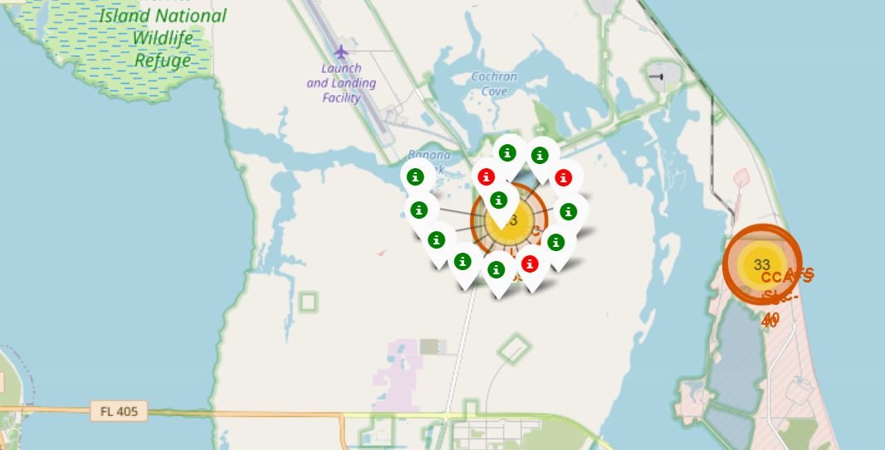
The success/failed launches for KSC LC-39A
Replace <Folium map screenshot 2> title with an appropriate title
Explore the folium map and make a proper screenshot to show the color-labeled launch outcomes on the map
Explain the important elements and findings on the screenshot
Each green marker represents a success launch
Each red marker represents a failed launch

Slide 37
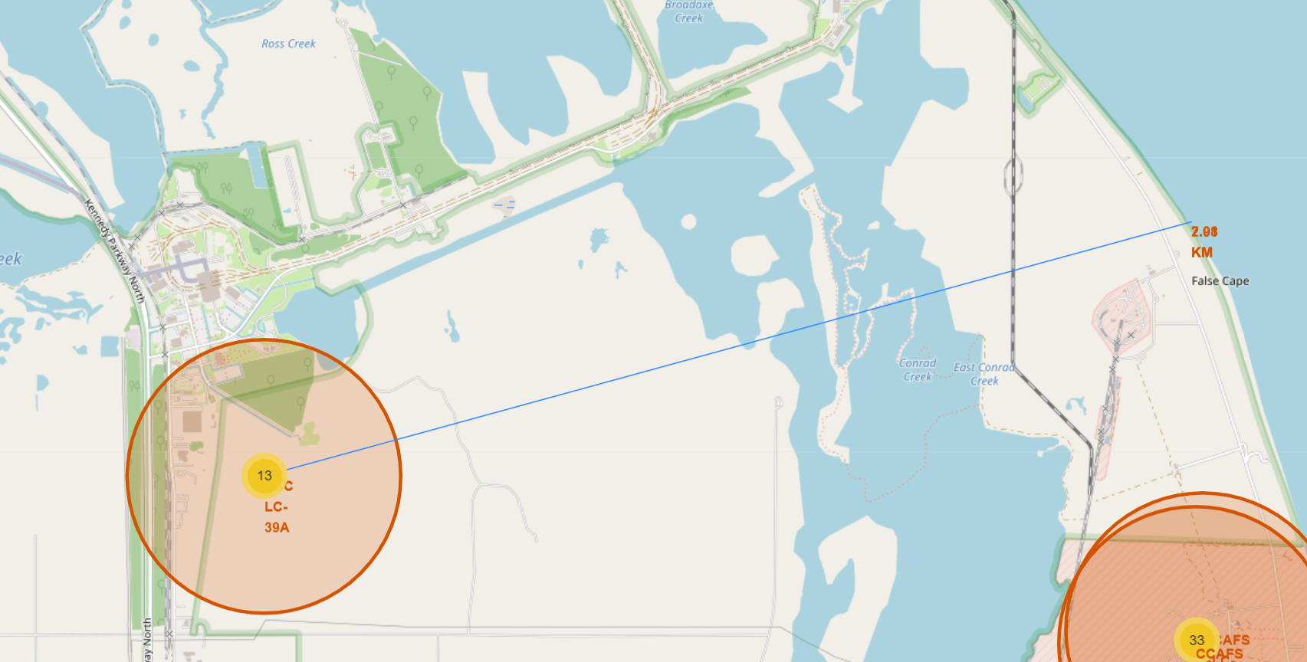
The distance between the coastline point and the KSC LC-39A launch site
Replace <Folium map screenshot 3> title with an appropriate title
Explore the generated folium map and show the screenshot of a selected launch site to its proximities such as railway, highway, coastline, with distance calculated and displayed
Explain the important elements and findings on the screenshot
All launch sites are near a coast
The KSC LC-39A launch site is 2.98km away from the coastline point

Slide 38

Section 4

Slide 39
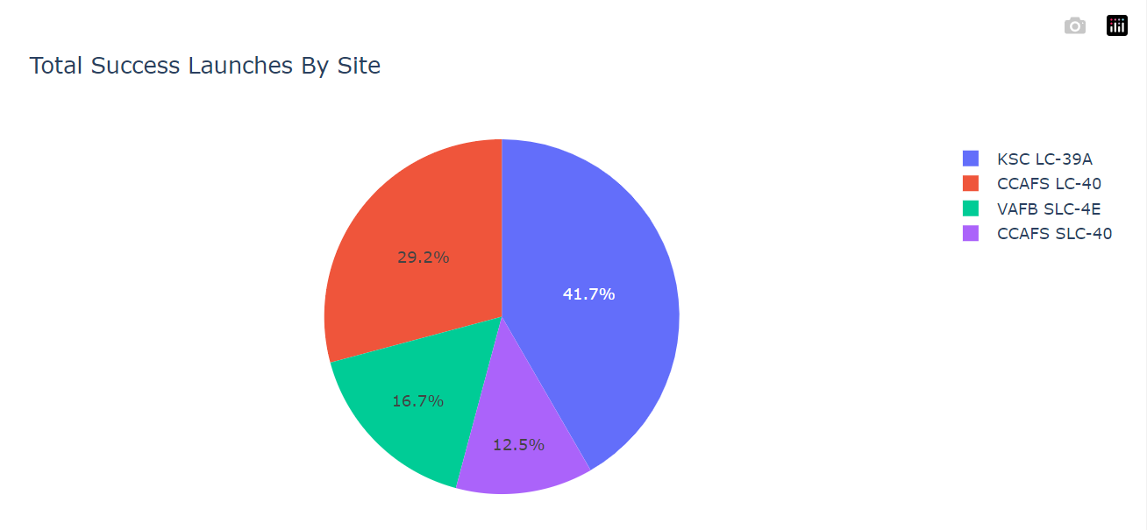
Total Success Launches by All Sites
Replace <Dashboard screenshot 1> title with an appropriate title
Show the screenshot of launch success count for all sites, in a piechart
Explain the important elements and findings on the screenshot
KSC LC-39A has the highest launch success amount.

Slide 40
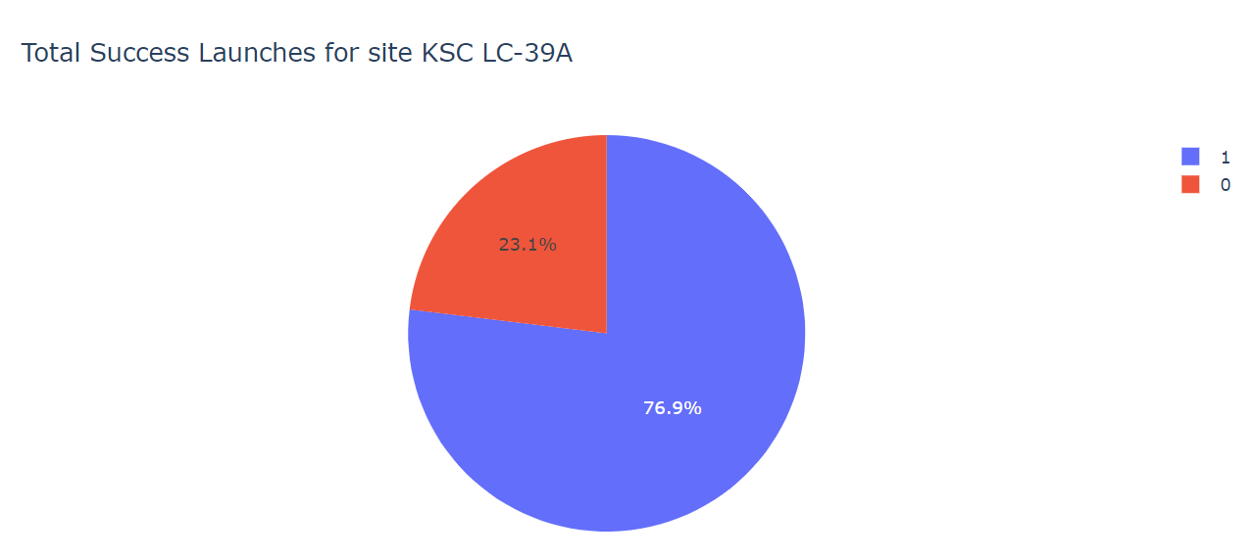
Highest Launch Success Ratio
Replace <Dashboard screenshot 2> title with an appropriate title
Show the screenshot of the piechart for the launch site with highest launch success ratio
Explain the important elements and findings on the screenshot
KSC LC-39A has the highest Launch Success Ratio.

Slide 41
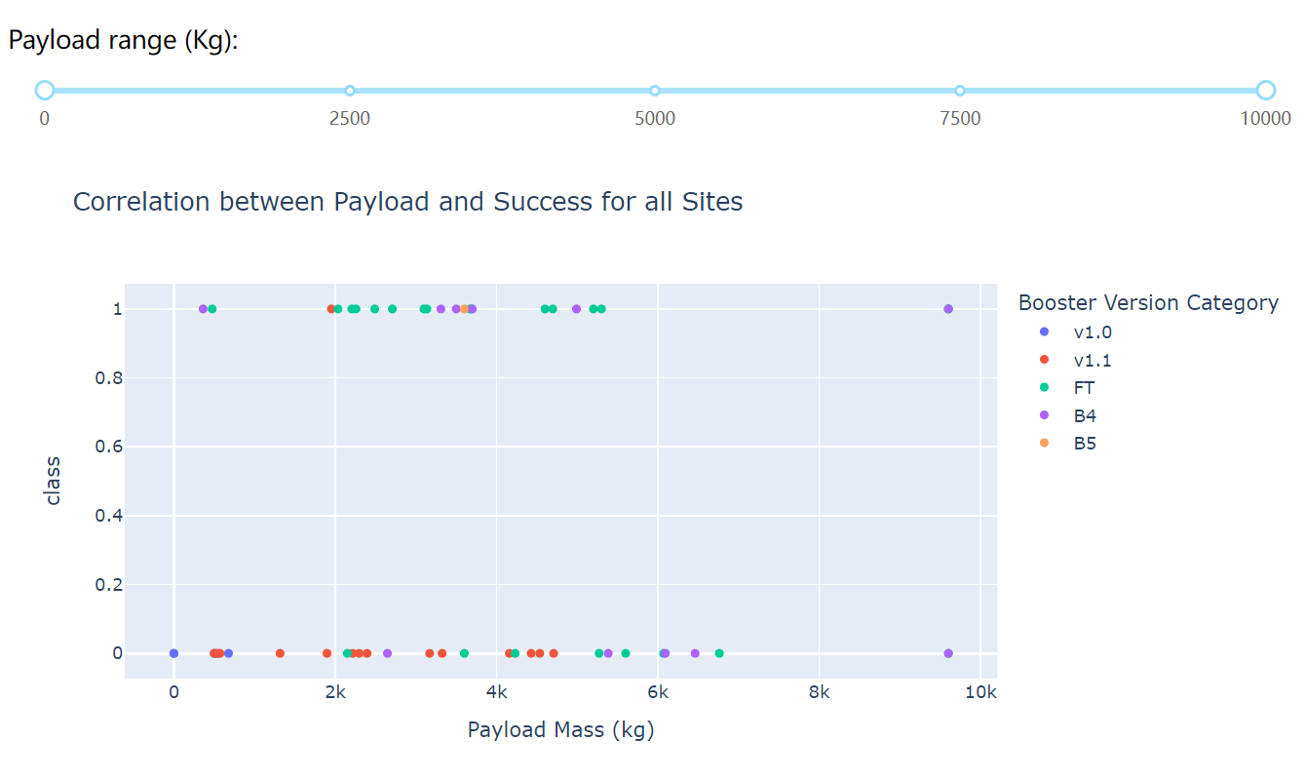
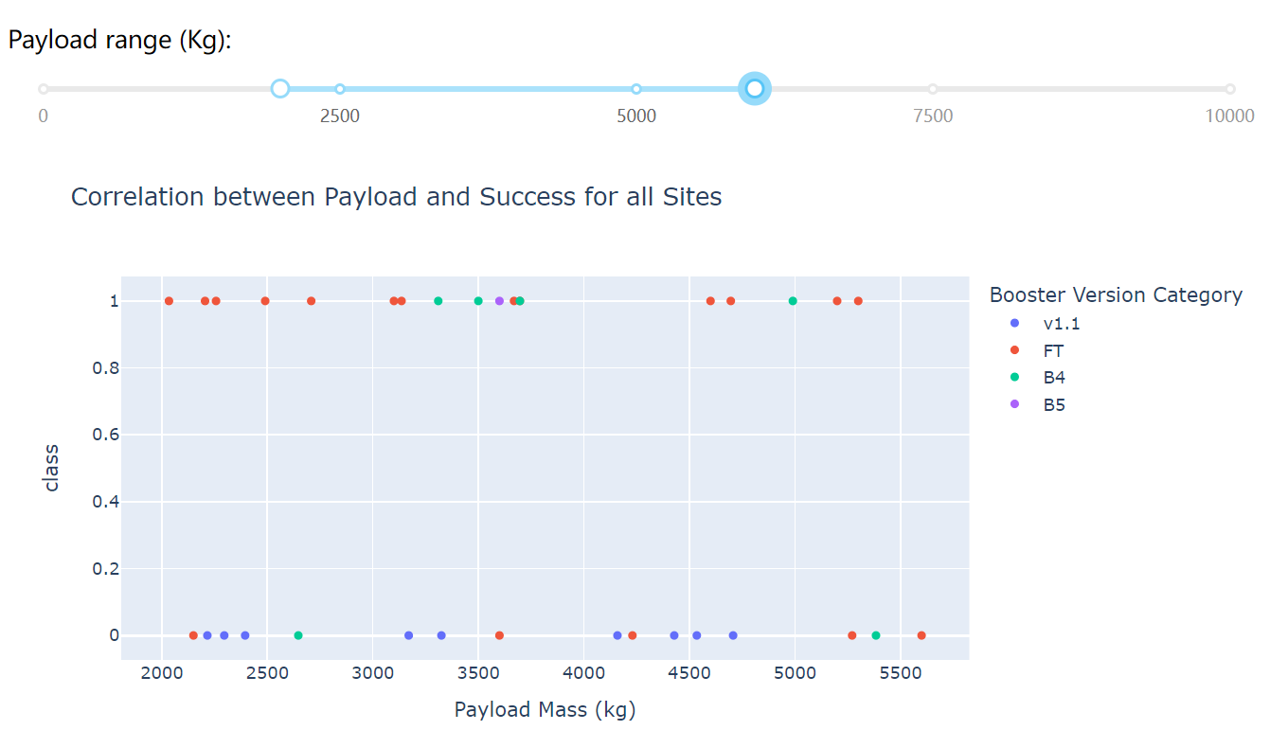
<Dashboard Screenshot 3>
Replace <Dashboard screenshot 3> title with an appropriate title
Show screenshots of Payload vs. Launch Outcome scatter plot for all sites, with different payload selected in the range slider
Explain the important elements and findings on the screenshot, such as which payload range or booster version have the largest success rate, etc.
When the payload is between 2000~55KG the Launch Success Ratio is the highest

Slide 42

Section 5

Slide 43
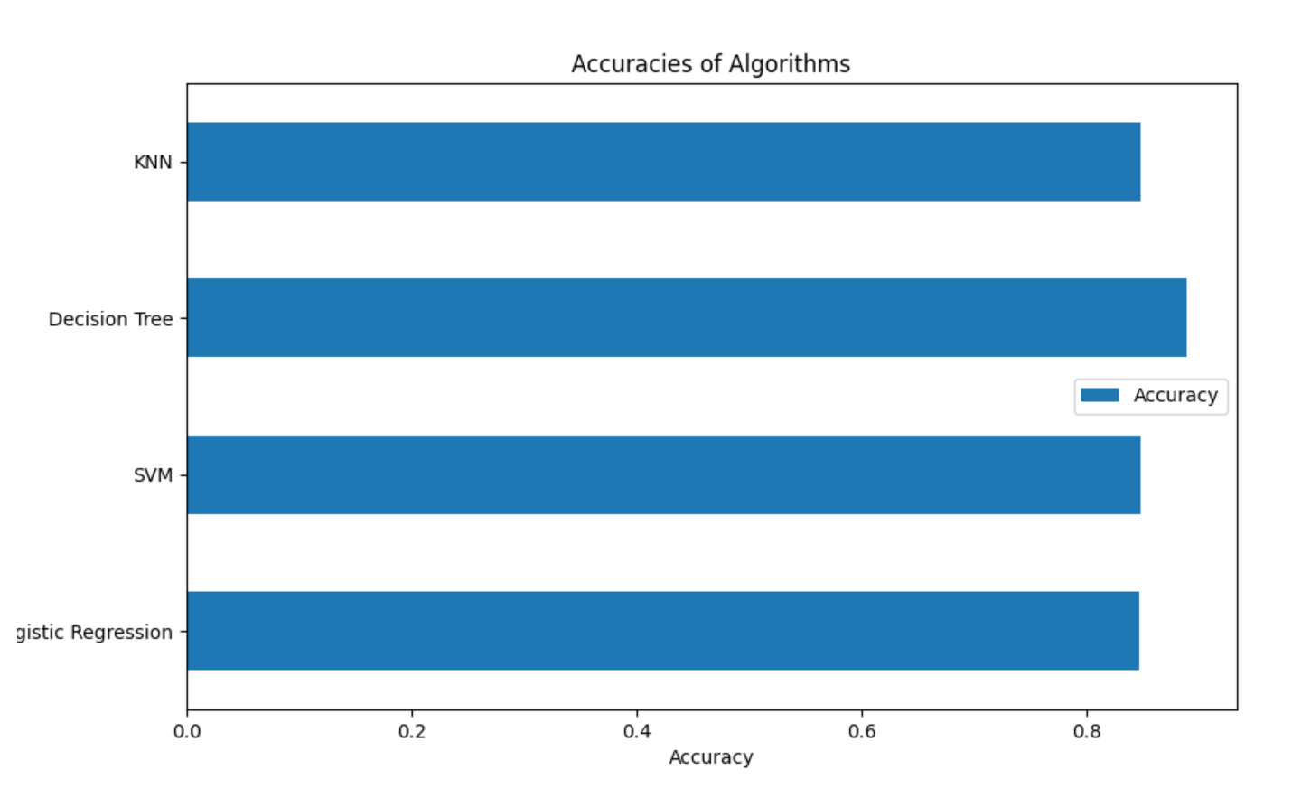
Classification Accuracy
Visualize the built model accuracy for all built classification models, in a bar chart
Find which model has the highest classification accuracy
The Decision Tree Algorithm has the highest classification accuracy

Slide 44
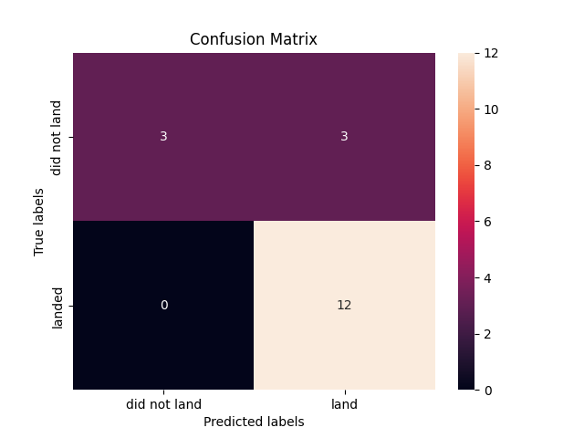
Confusion Matrix
Show the confusion matrix of the best performing model with an explanation

Slide 45
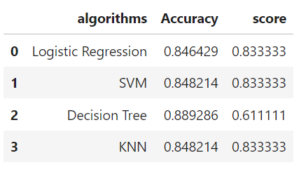
Conclusions
Point 1
Point 2
Point 3
Point 4
…

Slide 46
Appendix
https://github.com/zhq5101/learning-data-science/blob/main/jupyter-labs-spacex-data-collection-api.ipynb
https://github.com/zhq5101/learning-data-science/blob/main/jupyter-labs-webscraping.ipynb
https://github.com/zhq5101/learning-data-science/blob/main/jupyter-labs-eda-dataviz.ipynb
https://github.com/zhq5101/learning-data-science/blob/main/jupyter-labs-eda-sql-coursera_sqllite.ipynb
https://github.com/zhq5101/learning-data-science/blob/main/spacex_dash_app.py
https://github.com/zhq5101/learning-data-science/blob/main/SpaceX_Machine_Learning_Prediction_Part_5.jupyterlite.ipynb

Slide 47


